Slide 1
Institutional Slide Deck
A source deck for use in university presentations
Division of University Relations
Updated September 2021

Slide 2
About Stevens
A premier, private research university with a mission to inspire, nurture and educate leaders in tomorrow’s technology-centric environment while contributing to the solution of the most challenging problems of our time

Slide 3
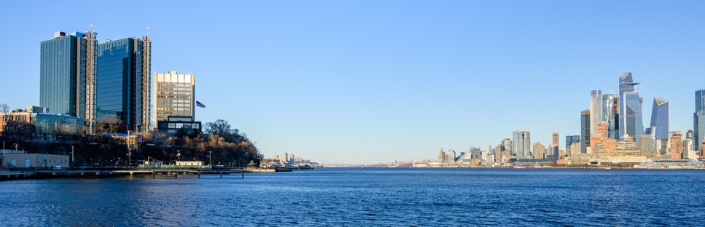
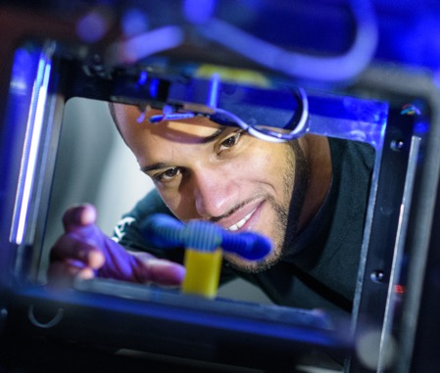
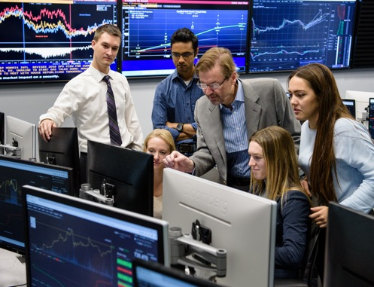
A Student-Centric, Technological Research University
Established in 1870 by America’s “first family of inventors”
Located in Hoboken, New Jersey, minutes from Manhattan
Prepares leaders for our technology-driven world
Advances science and technology education and research in areas of great societal need
Contributes to the study and solution of the most challenging problems of our time

Slide 4
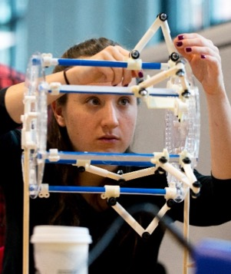
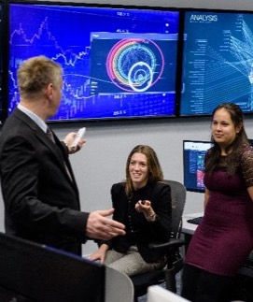
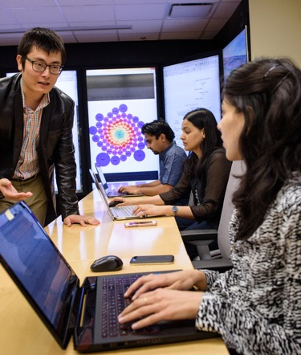
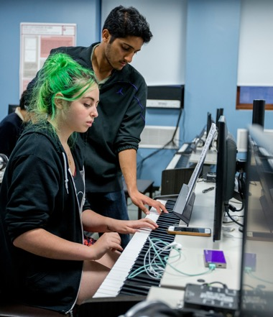
Technology-Focused, Broad Reach
Charles V. Schaefer, Jr. School of Engineering and Science
Advancing scientific knowledge to create groundbreaking solutions to 21st-century challenges
School of Business
Leading innovation in business management and finance, across industries and around the globe
School of Systems and Enterprises
Optimizing the design, creation and operation of complex systems and organizations
College of Arts and Letters
Uniting humanities, arts, science and technology to inspire and inform change and innovation

Slide 5
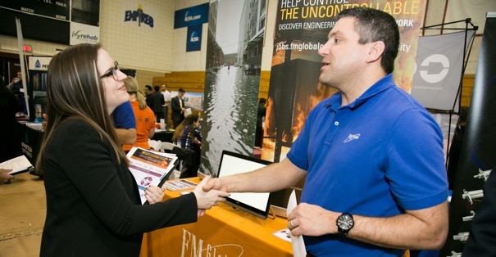
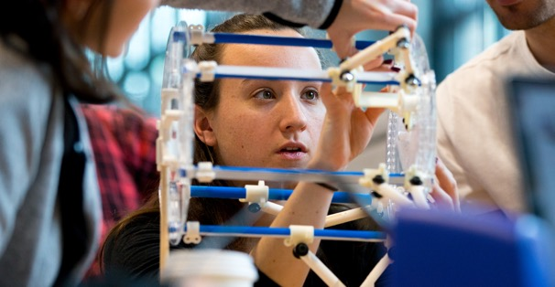
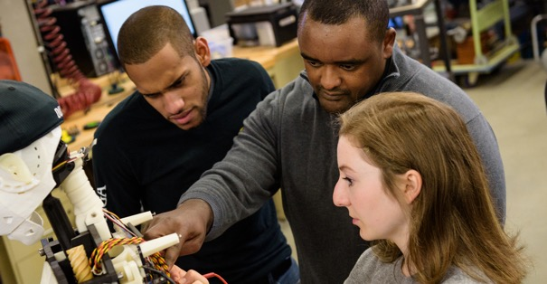
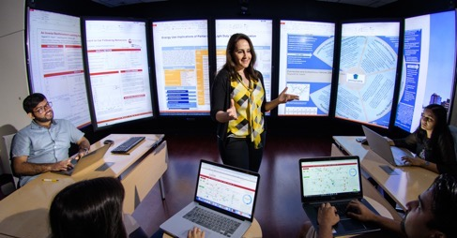
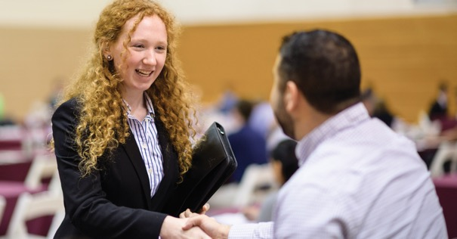
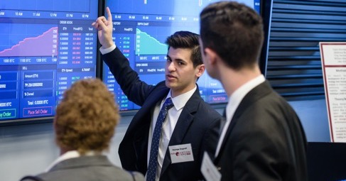
Driven by Real-World Experience
Cooperative education
Project-based learning
Faculty-mentored research
Case studies drawn from industry
Internships
Cross-disciplinary collaboration, reflective of real-world projects

Slide 6
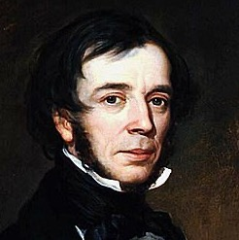
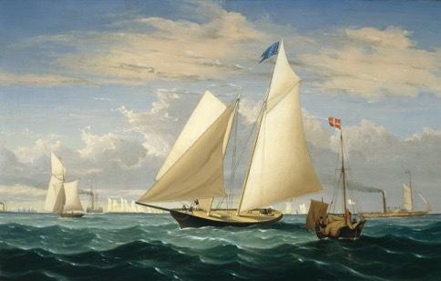
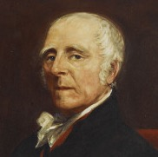
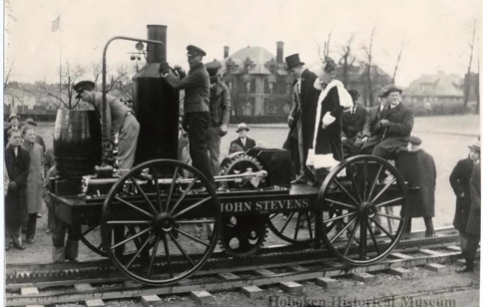
Legacy of Innovation
The Stevens family: The first family of American inventors
Introduced the first mechanical engineering degree in the U.S.
Designed the steam ferry, the T-rail and the first American-built steam locomotive
Built and operated the first U.S. commercial railroad
Instrumental in developing U.S. patent law
Created the America’s Cup racing series and designed and sailed the yacht America, the first winner of the Cup
Edwin A. Stevens
The yacht America
Colonel John Stevens III
John Stevens’ original steam carriage

Slide 7
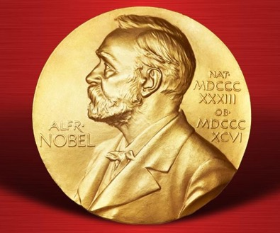
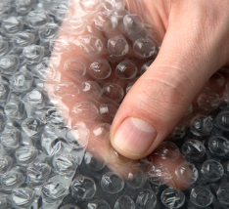

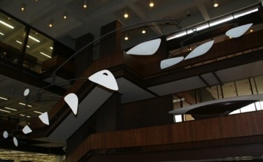
Once and Future Pioneers
Stevens alumni have followed in the footsteps of the university’s founding family to become modern-day game-changers.
Created the field of scientific management
Invented the Gantt Chart
Co-founded GM and Texas Instruments
Won a Nobel Prize for discovering the neutrino
Created the art form known as the mobile
Directed command, service and lunar module design for NASA’s Apollo moon missions
Invented the IMAP email protocol
Invented bubble wrap

Slide 8
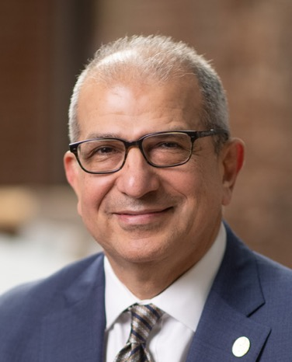
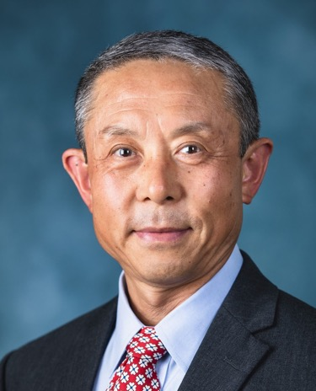
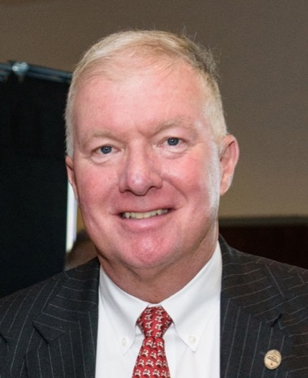
Stevens Leadership
Nariman Farvardin, President
A distinguished higher education leader and accomplished researcher, entrepreneur and inventor in data communication, image coding and wireless communication
Jianmin Qu, Provost & VP for Academic Affairs
An accomplished academic administrator and an acclaimed scholar in the field of theoretical and applied mechanics
Stephen T. Boswell, Chairman of the Board of Trustees
President and CEO of Boswell Engineering, co-founder of ConnectOne Bank and trustee of Hackensack Meridian Health

Slide 9

Foundational Research Pillars
Areas of Focus
Artificial Intelligence, Machine Learning and Cybersecurity
Biomedical Engineering, Healthcare and Life Sciences
Complex Systems and Networks
Data Science and Information Systems
Financial Systems and Technologies
Resilience and Sustainability
More than $46 million in research awards during FY20

Slide 10
University Facts
3,791 Undergraduate Students | 3,466 Graduate Students | 12:1 Undergraduate Student-Faculty Ratio | 328 Full-Time Faculty (including lecturers)
34 Undergraduate Majors | 56 Master’s Programs | 22 Ph.D. Programs | DEGREES: B.E., B.S., B.A., Engineer, M.S., M.A., M.Eng., MBA, Ph.D.
16 Active Research Centers | 93% First-Year Retention Rate | 88% 6-Year Graduation Rate
Enrollment figures reflect Fall 2020 census

Slide 11






National Rankings and Recognition
#17
For Return on Investment
20-year net return on investment, 2020 College ROI Report
#4
Top Earnings
Ranked among the 25 U.S. “colleges where students go on to earn the most money,” 2018
8
Increase
In U.S. News & World Report’s ranking of National Universities, from 88 in 2012 to 80 in the 2021 edition
Among the Most Innovative Colleges
U.S. News & World Report National Universities, 2021 edition
#11
Career Placement
Best Value Colleges, 2020
Top 15
For Internships
Best Value Colleges, 2020
#12
For Mid-Career Salaries
2020-2021 College Salary Report
#2
For Gender Equity in Starting Salary
As reported in Forbes, 2018
#14 For Return on Investment 40 Years After Enrollment
Georgetown University Center on Education and the Workforce’s “A First Try at ROI,” 2019

Slide 12
National Graduate Program and School Rankings
#8
Online Graduate Computer Information Technology Programs
U.S. News & World Report, 2021
#14
Online Graduate Business
Programs (non-MBA)
U.S. News & World Report, 2021
#68
Best Business Schools
U.S. News & World Report Best Graduate Schools, 2022 edition
#35
Online MBA
U.S. News & World Report, 2021
#21
Online Graduate Engineering Programs
U.S. News & World Report, 2021
#79
Best Engineering Schools
U.S. News & World Report Best Graduate Schools, 2022 edition
#16
Online MBA Specialties for Business Analytics U.S. News & World Report, 2021
#8
Online Engineering Specialties for Industrial/Systems Engineering U.S. News & World Report, 2021
#31
Best Industrial / Systems / Manufacturing Engineering Program
U.S. News & World Report Best Graduate Schools, 2022 edition

Slide 13
A University on the Rise
Undergraduate Class, Entering Fall 2020 SAT Range: 1320-1480
(middle 50%)
Unprecedented
Graduate Enrollment Growth
Prospective student interest is stronger than ever.
187%
10,346 First-Time, Full-Time Applicants
247%
11,184 Applications
64%
918 First-Time, Full-Time New Students
15%
3,466 Graduate Enrollment
56%
3,791 Undergraduate Enrollment
67%
2,202 Full-Time Graduate Students
Enrollment figures reflect Fall 2020 census data. Percent increases reflect growth since 2011.

Slide 14
Lifelong Returns
Stellar student outcomes are a Stevens standard
$77,000
Average starting salary of graduates
95%
of students secured intended outcomes within six months of graduation
77%
had their outcomes finalized prior to graduation
Data from the Career Outcomes Report for the Class of 2020

Slide 15





Stevens in the News
National media attention for topics ranging from pandemics and biomedical engineering to politics and the economy
 | Nike’s Vaporfly shoes changed running, and the track and field world is still sifting through the fallout 2/9/2020 |  | Scientists solve mystery of bombardier beetle's hot, toxic spray 7/5/20 |  | New Jersey College Student Crafts Face Shields Between Classes to Help Nursing Homes, Hospitals Fight Coronavirus 1/13/20
 | Interview with Pandemic Expert Theresa MacPhail 4/3/2020 |  | Could a New Swine Flu Strain Mean a Second Pandemic? 7/2/20 |  | What a pandemic in America might look like 2/24/20
 | Bringing the ocean’s midnight zone into the light 9/22/20 |  | Stocks and bonds send mixed signals about economy 5/27/20 |  | ‘Election stress disorder’: How to cope with the anxiety as political tensions intensify 3/3/20
 | More colleges shift to online learning for fall semester 8/8/20 |  | Minding the GAAP: companies are using a wider range of accounting metrics to inform investors—and sometimes mislead them 1/24/20 |  | Fourth spy at Los Alamos knew A-Bomb’s inner secrets 1/27/20

Slide 16

Global Reach
A vast international network offers boundless opportunities in our global economy.
Students from 43 states and 62 countries and alumni from every region of the world
Global international student exchange agreements
Study abroad opportunities
Global academic partnerships
Worldwide research programs
Partnerships with multinational corporations and governments

Slide 17
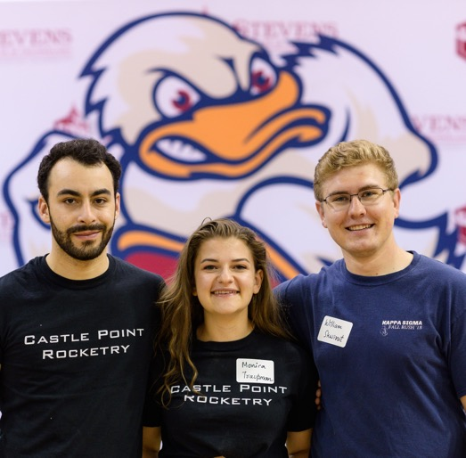
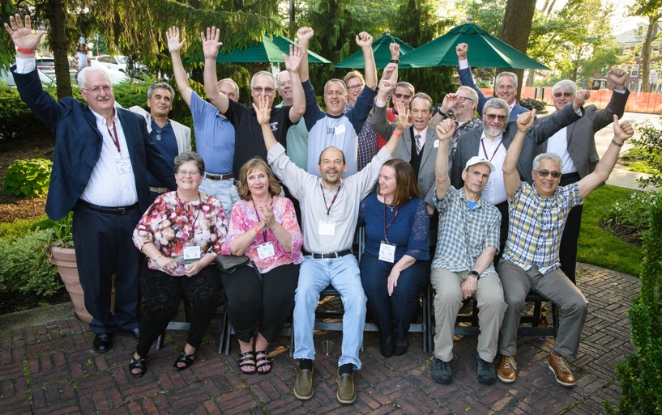
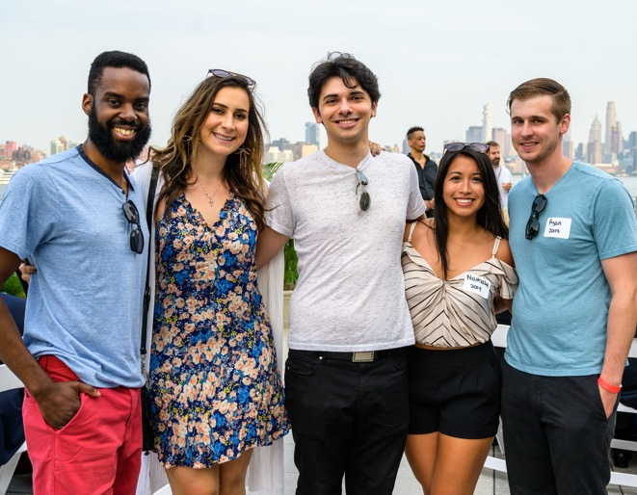
The Stevens Alumni Network
Stevens alumni are leaders in companies as diverse as United Technologies Corporation, PSEG, Healthfirst, Merck, Citibank, SAP, Goldman Sachs and AT&T.
50,000+ Alumni
More than 86
countries represented
20+ official clubs worldwide

Slide 18
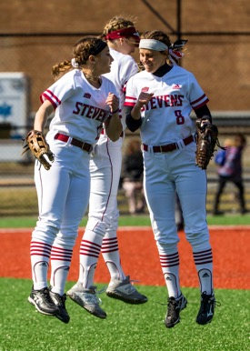
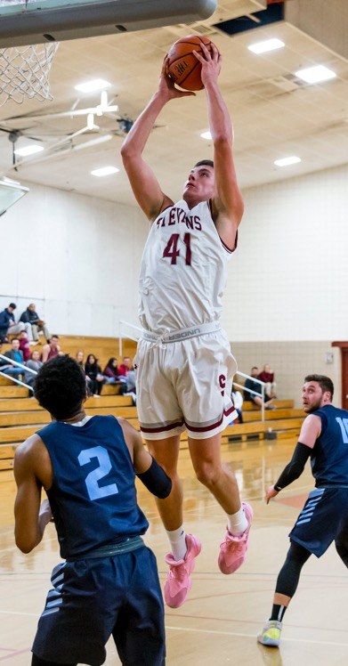

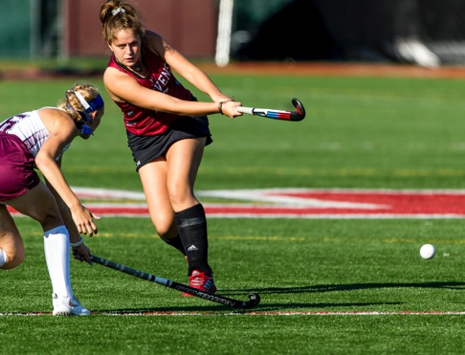
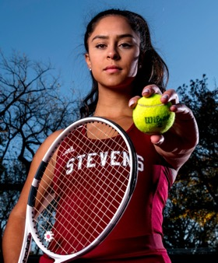
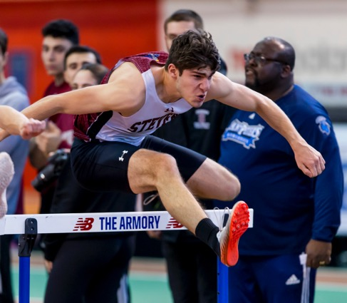
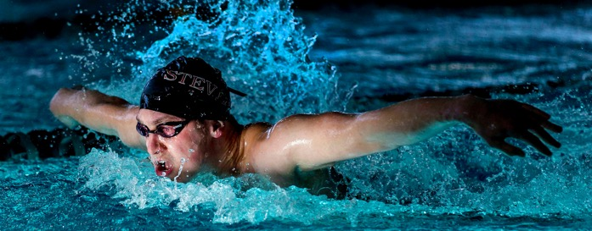
Athletics
25 NCAA Division III Varsity Sports
Member of the Middle Atlantic Conference (MAC) and the MAC Freedom
Combined cumulative GPA for all varsity sports > 3.5
29 CoSIDA Academic All-Americans since 2011
14 national championships since 2011
11 consecutive top-45 finishes in the Learfield IMG College Directors’ Cup Division III Final Standings

Slide 19
Innovation Applied
A unique and powerful academic experience

Slide 20

Research Centers and Labs
Center for Complex Systems and Enterprises (CCSE)
Center for Decision Technologies (CDT)
Center for Environmental Systems (CES)
Center for Healthcare Innovation (CHI)
Center for Innovation in Engineering and Science Education (CIESE)
Center for Neuromechanics
Center for Quantum Science and Engineering (CQSE)
Davidson Laboratory
Hanlon Financial Systems Center (FSC)
Highly Filled Materials Institute (HfMI)
Laboratory for Multiscale Imaging (LMSI)
MicroDevice Laboratory
The New Jersey Center for MicroChemical Systems (NJCMCS)
Sensor Technology & Applied Research Center (STAR)
Stevens Alliance for Innovation and Leadership (SAIL)
Stevens Institute for Artificial Intelligence (SIAI)

Slide 21
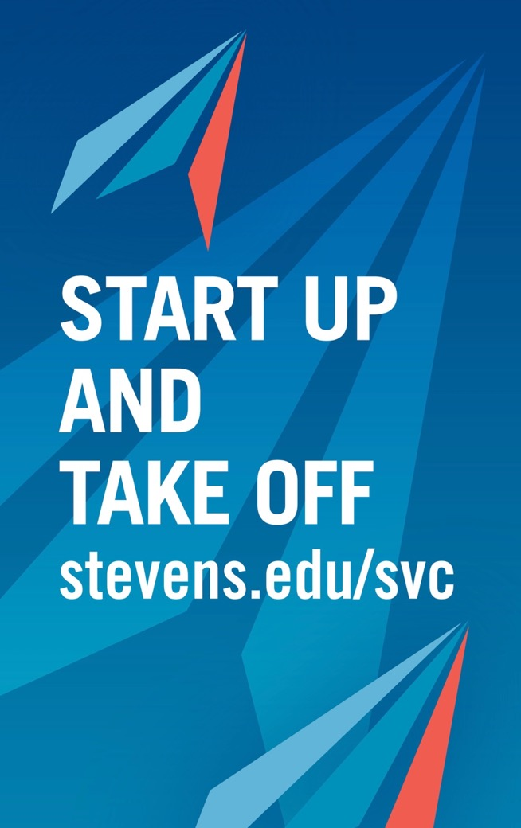
The Stevens Venture Center: Fueling Entrepreneurship
A dynamic, collaborative environment where selected entrepreneurs can develop promising concepts and technologies into thriving businesses
Technology support
Opportunities to share best practices and experiences
Networking
Access to legal and accounting experts and investors
Education in building a successful business
The SVC provides the infrastructure, resources, training and support to bring entrepreneurial dreams closer to reality.

Slide 22




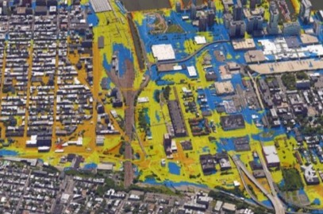



Shaping the Future
Stevens research tackles some of the most urgent challenges facing our world today.
Resilient engineering
Energy innovation
Healthcare delivery
Nuclear preparedness and civil defense
Flood forecasting and preparation
Biomedical research and drug discovery
Cybersecurity
Healthcare analytics

Slide 23
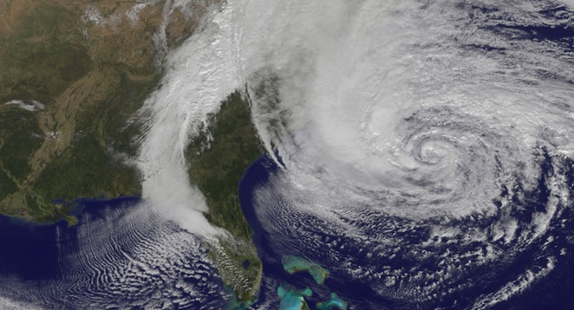
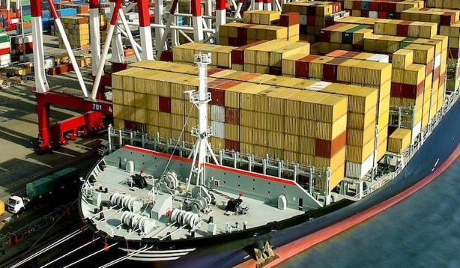

National Centers of Excellence
Maritime Security Center (MSC)
A Department of Homeland Security Science & Technology (S&T) National Center of Excellence
Director: Hady Salloum
Systems Engineering Research Center (SERC)
A University-Affiliated Research Center of the U.S. Department of Defense
Director: Dinesh Verma

